Slide 1



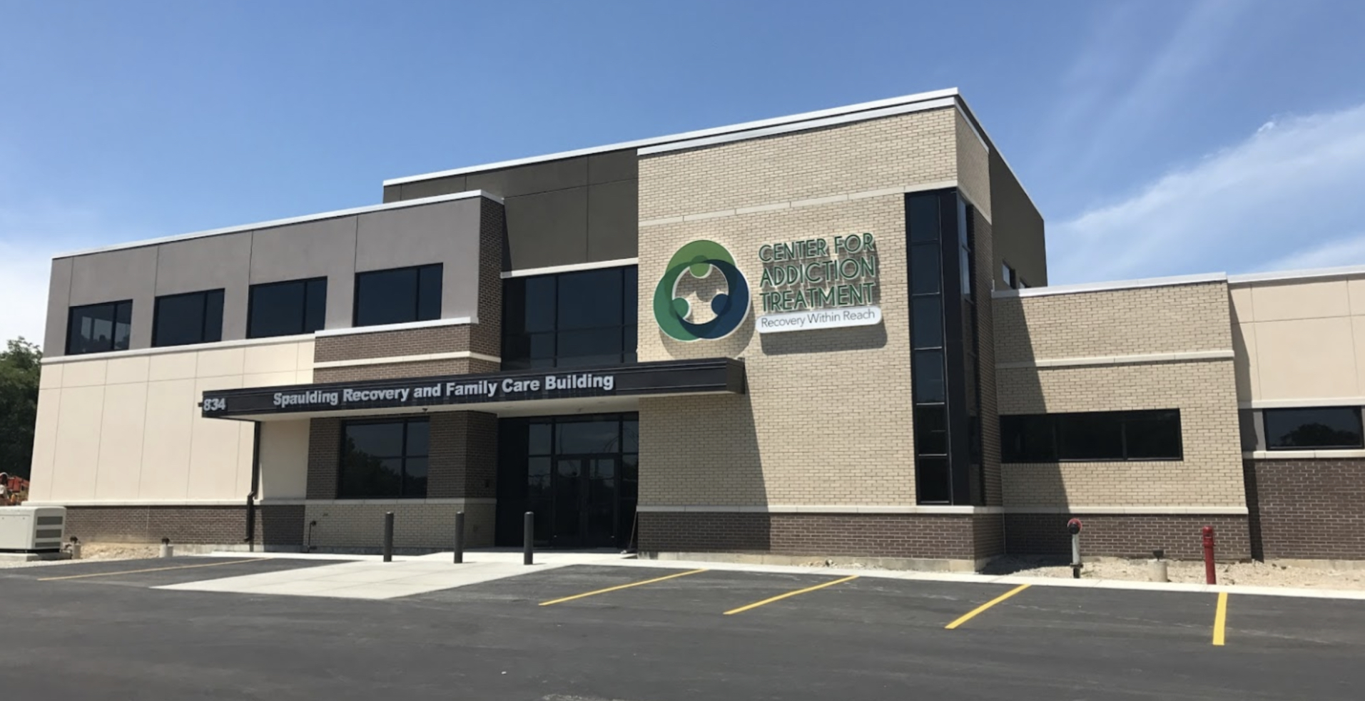
Promoting Hepatitis A and B Vaccination
at the Center for Addiction Treatment
Joseph A. Zegar, Urban Health Project 2019, University of Cincinnati College of Medicine
About the Center for Addiction Treatment
The Center for Addiction Treatment (CAT) has been open since 1970, always viewing addiction as a disease that requires medical treatment rather than punishment. At CAT, there are numerous services available to guide patients on a path towards recovery.
Services at CAT include:
An inpatient detox program
A medically-assisted treatment (MAT) clinic, where patients can receive Suboxone, Vivitrol, and other medications to help fight addiction
Access to recovery networks, counseling, and other services to keep patients connected and involved
Monarch Primary Care, an on-site clinic that offers primary care services from nurse practitioners with training in addiction medicine
Intern Responsibilities
Most of my time was spent educating patients about hepatitis A and B and evaluating lab reports to identify candidates for vaccination. All patients taking part in the inpatient detox program have their blood drawn, so I reviewed these results, discussed them with the patients, and recommended vaccination when indicated.
Additionally, part of my time was spent assisting with patient histories and physicals, observing in the MAT clinic, and developing a potential workflow to ensure vaccination continues after my internship ends.
Project Overview
Vaccination against hepatitis A and B is recommended for many groups, including people that have a history of injection drug use.¹ Administering Twinrix, a vaccine against hepatitis A and B, can help protect CAT patients should they be exposed to the virus in the future. Therefore, this project focused on developing a program for vaccinating patients during inpatient treatment or when receiving primary care at Monarch.
The process for vaccination included:
Patients that consent to having their blood drawn receive information about hepatitis and Twinrix
Lab results are reviewed by the UHP intern and a nurse practitioner to determine if a vaccination is indicated
Patients are contacted and offered the vaccine
If agreeable, patients receive the first dose and education on the need for all 3 doses
Patients are contacted about their future doses until the series is completed
Education
Education was critical when encouraging vaccination. All patients received information about hepatitis, risk factors for exposure, and an overview of the vaccine. Additionally, patients with hepatitis C were strongly encouraged to receive the vaccination to decrease the chance of additional liver damage. The need for all three doses was also emphasized to encourage patients to return for future vaccines. To facilitate this, all patients received a reminder card after each vaccine.
Conclusion
This project demonstrates both the need for increased vaccination and the barriers that prevent it being more commonly done at CAT. In this project, 49% of eligible patients left before ever getting offered a vaccine. Additionally, it would be interesting to continue following patients and determine how many return to complete the vaccination series in the coming months.
In the future, it may be beneficial to find ways to receive separate hepatitis A and B vaccines to better tailor therapy. Furthermore, there is some research supporting a modified vaccination schedule that provides hepatitis B protection after 3 shots over 21 days.² This schedule may be better for this particular patient population, since follow up is extremely difficult.
Ultimately, this project was able to describe the vaccination status of patients at CAT and facilitate 22 patients receiving the hepatitis A and B vaccine. These efforts will ideally improve the health of those seeking care at the Center for Addiction Treatment and lead to the continuation and expansion of vaccine services.
References
1. Quaglio G, Lugoboni F, Mezzelani P, Des Jarlais DC, Lechi A. Hepatitis vaccination among drug users. Vaccine. 2006;24(15):2702-09.
2. Marchou B, et al. Three-week hepatitis B vaccination provides protective immunity. Vaccine. 1993;11:1383-85.
Acknowledgements
Thank you to Dr. Deborah Frankowski, Tracy Martin, APRN, Kristen Wright, APRN and all the staff at Monarch Primary Care for their assistance with the development and execution of the project and internship experience.
Results
A total of 84 patients were included in this project. Other patients were excluded because they refused a blood draw, their results never came back, or the results were incomplete. Of those with results, 20 had an indication for the hepatitis A vaccine alone, 12 had an indication for the hepatitis B vaccine alone, and 31 required both vaccines. All of these patients were offered vaccination and education.
Almost half of patients eligible for vaccination either left against medical advice or were discharged before results could be discussed. However, of those still present, 69% were agreeable to vaccination when offered. As of the time of project conclusion, a total of 22 people have received at least one dose of Twinrix. Additionally, vaccination is being introduced into the clinic workflow.

